Slide 1

Winshare
Joshua Collins, Omer Gafar, Shimu Pan, Izik Bakhshiyev, Louis Hung, Pranay Sharma

Slide 2
Overview
What is WinShare?
A platform designed for sports enthusiasts, specifically NBA fans, to predict player and team performance
Uses real-time and historical data analytics for game predictions and insights
Key Features:
Real-Time Predictions & Data Analytics
Competitive Leaderboard that tracks top users for accuracy and points
Why Use WinShare?
Access to comprehensive NBA data
Test and improve your sports knowledge
Join a competitive community of NBA fans
Notes:
What is winshare, winshare is a basketball web app that’s designed to provide live stats and game to game analysis. Our platform uses prior games, team and player form along with other variables to accurately predict future games. Our app will also include a points system where users can use the information we provide to predict the outcome of games and results will be posted on our interactive leaderboard ranking players by accuracy and point total.

Slide 3
Functional and Non-Functional Requirements
Functional Requirement
Provide real-time and historical NBA statistics for players and teams.
Prediction system about game outcomes and player performances.
Global and friend leaderboard.
“Wallet” system that stores points for each user
Non-Functional Requirement
Dynamic leaderboard updates (once every 30 minutes).
Streaks, achievements, and badges for correct predictions.
Pull up to date statistics on basketball games from server and live games.
Daily and weekly reward system that rewards points for users.

Slide 4
Technologies & Techniques Used
Structure & styling:
For each webpage, HTML is used for the structure
To style these pages, CSS is also used
On-Point Analysis & effects:
For our personal analysis of data and for adding effects to web pages, we will be using JavaScript
Account & Leaderboard management:
To be able to manage users accounts and their place on the leaderboard, we will use PHP & MySQL
Gathering data:
We intend to collect live data using the NBA’s API

Slide 5
Users
James Holden Smith
19 Years Old
Caucasian male college student
Joins roommate’s Fantasy league
Doesn’t want to be punished for coming in last place ( 24 hours in a Waffle House )
Joins WinShare to understand how to draft a good team by making predictions on the performance of several players
Geraldine Thompson
56 years old
Caucasian female
Married to NBA fanatic, Timothy Thompson
Timothy spends every weekend watching sports, his favorite league being the NBA.
Geraldine wants to spend more time with him
She plays on WinShare to get a better understanding for basketball

Slide 6





Stakeholders
Our web app's stakeholders include:
NBA (primary sponsor and sports league)
Fanatics (points incentive feature sponsor)
Tech firms (IBM, AWS, Google Cloud for promoting analytics services)
Sports equipment/apparel (Nike, Adidas, Under Armour for exclusive promotions/merchandise)
Media networks (ESPN, Fox Sports for cross-promotion of shows and events)
These partnerships will drive multiple revenue streams through targeted ads, promotions, and increased user engagement.

Slide 7
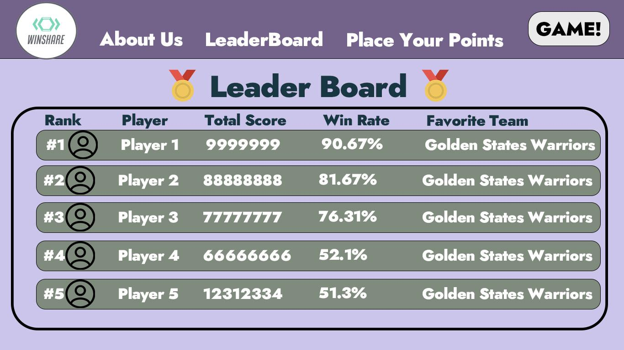
Wire Frames

Slide 8
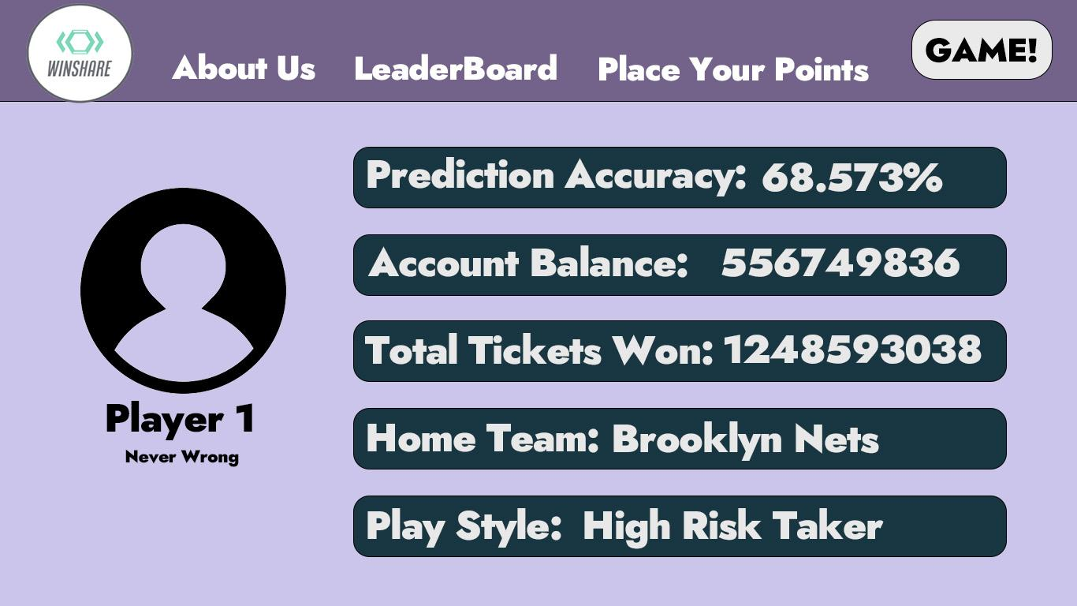
Wire Frames

Slide 9
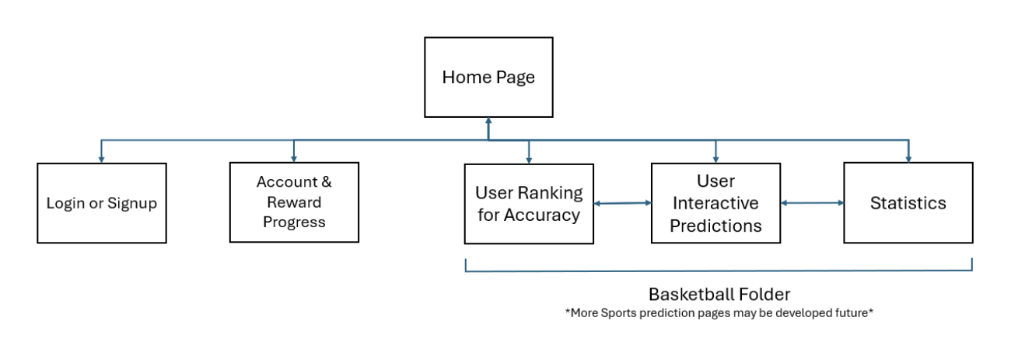
Site Map

Slide 10
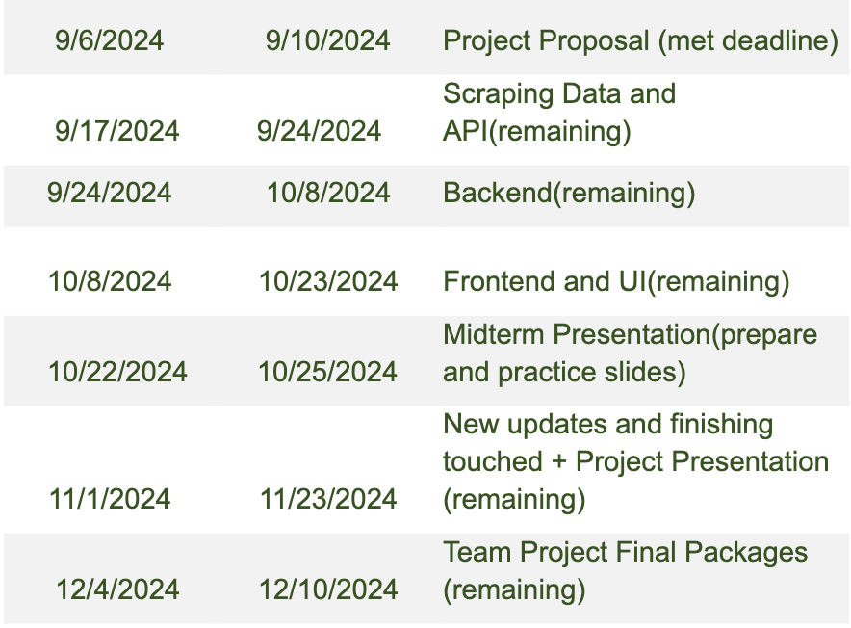
Expected Timeline

Slide 11
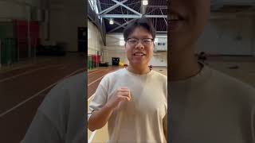
Promo Video
https://youtube.com/shorts/mWwRJyD0O9A?si=YGIouq2I8b_CU7Yt

